Slide 1
NLP 2

Slide 2
Language generation (NLG)
The process of producing meaningful phrases and sentences in the form of natural language.
Can be used to produce long form content for organizations to automate custom reports, as well as produce custom content for a web or mobile application.
It can also be used to generate short blurbs of text in interactive conversations (a chatbot) which might even be read out by a text-to-speech system.

Slide 3
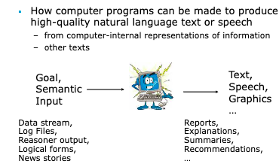

Slide 4
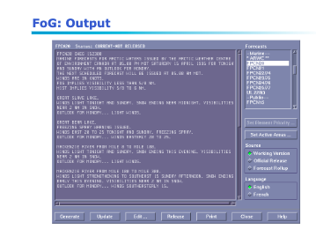
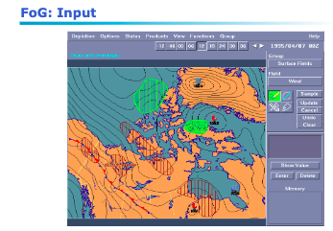
Example:

Slide 5
NLG is all about making choices:
Content to be included/omitted
Organization of content into coherent structure
Style (formality, opinion, genre, personality...)
Packaging into sentences
Syntactic constructions:
How to refer to entities (referring expression generation)
What words to use (lexical choice)

Slide 6
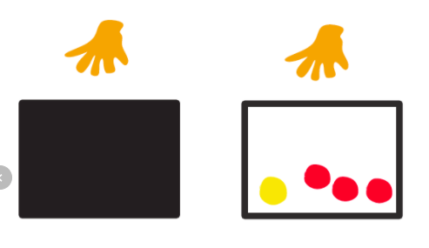
Analogy from classic probability
We take a ball from a box and then check its color.
What is the probability that the ball is red?
Pr(ball=red)=
|red balls|/|all balls in the box|

Slide 7

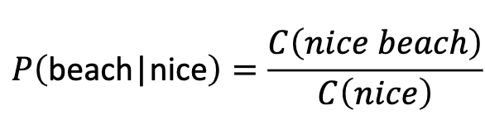
Language model:
The task of predicting the next word, given the words so far.
Goal: To estimate the probability of a word sequence
Earlier models (N-gram models):
Probability is conditioned on a window of (n-1) previous words
Estimate the probability based on the training data

Slide 8
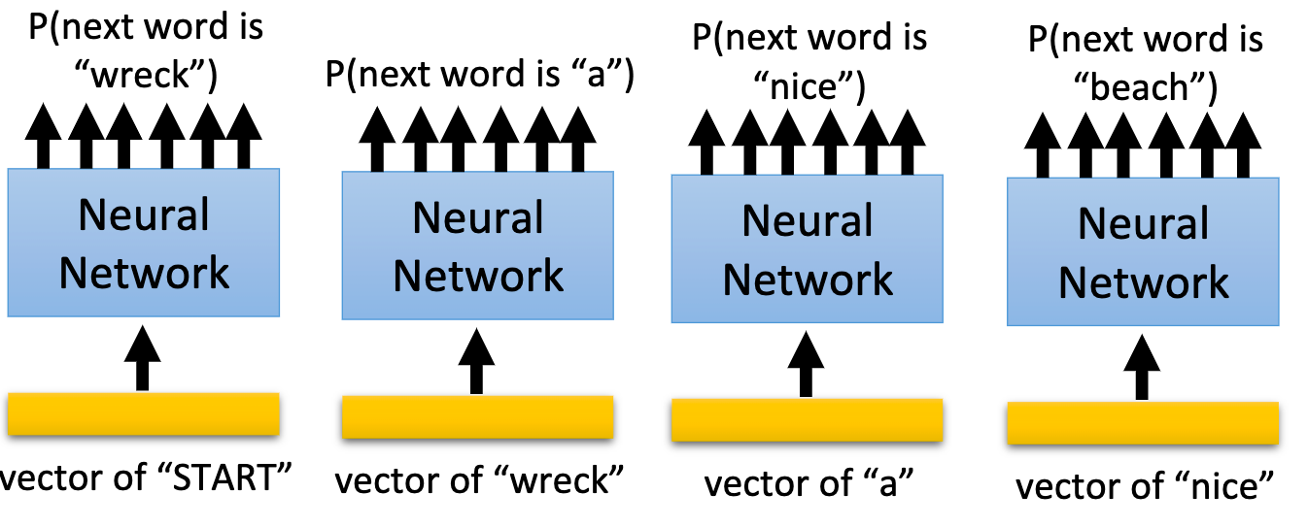

NN-based language model
$$P(“wreck a nice beach”) = P(wreck|START)P(a|wreck)P(nice|a)P(beach|nice)$$

Slide 9
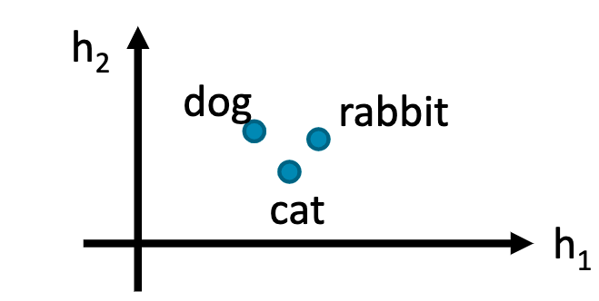
NN-based language model
Word embedding input
If the input layer (or hidden layer) of the related words(cat and dog) are close and P(jump|dog) is large,
P(jump|cat) increase accordingly(even if there is not “... cat jump ...” in the data)

Slide 10
Deep learning models for text data
Neural networks
Ordinary feed forward neural networks (could be deep with multiple internal nodes and layers)
Recurrent neural networks (with attention)
Use input data in sequential order, uses information about the ordering of tokens.
Convolutional neural networks
1-d CNN neural networks can selectively use information from previous tokens (based on how 1-d filters are defined, can be parallelized in GPU)
Transformers
Fully attention models that consider interaction of other tokens with current token (the model has many parameters and slow to train, but more accurate)

Slide 11
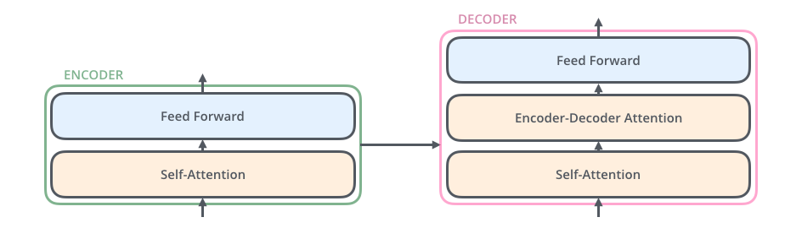
Transformers:
Trained on huge amount of training data
stacked layer of deep neural networks
self attention
Trained on genreral corpora to facilitate fine tuning on various tasks

Slide 12
GPT-2 Transformer language model(OPEN-AI)
GPT-2 is a large transformer-based language model with 1.5 billion parameters, trained on a dataset of
40GB of Internet text.
Trained on selected Reddit pages:
They created a new dataset which emphasizes diversity of content, by scraping content from the Internet.
GPT-2 is trained with a simple objective: predict the next word, given all of the previous words within some text.

Slide 13
Transformer

Slide 14
A gentle introduction
Broadly resembles the encoder-decoder architecture
Avoids recurrence/convolution – hence computationally efficient
Less time to train
More parallelizable
Key concepts
Attention
Self-attention
Multi-head attention
Positional encoding

Slide 15
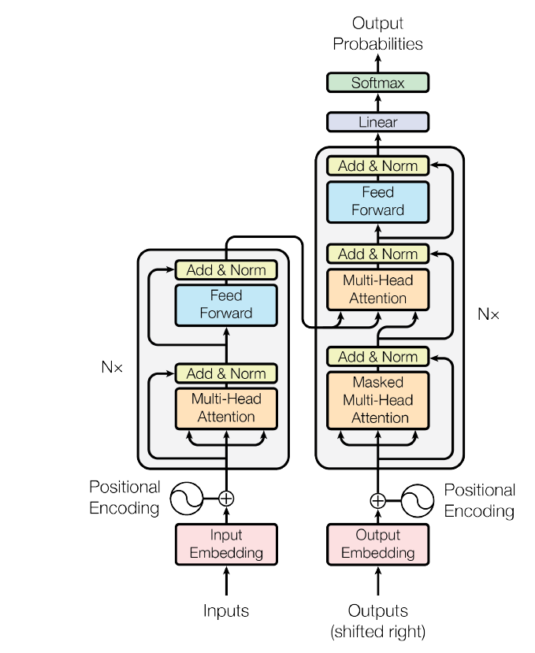
Preparing the input
Source: Attention Is All You Need by Vaswani et al

Slide 16
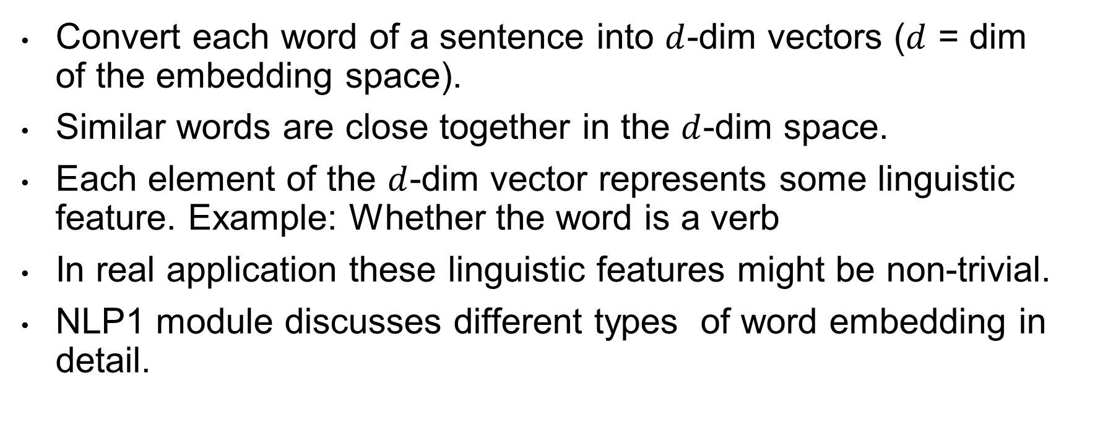
Word embedding
Convert each word of a sentence into $d$-dim vectors ($d$ = dim of the embedding space).
Similar words are close together in the $d$-dim space.
Each element of the $d$-dim vector represents some linguistic feature. Example: Whether the word is a verb
In real application these linguistic features might be non-trivial.
NLP1 module discusses different types of word embedding in detail.

Slide 17

Illustration (word embedding)
Twinkle twinkle little star how I wonder what you are
.2
.13
.46
.74
.83
.2
.13
.46
.74
.83
.3
.1
.2
.4
.18
Converting each word into a vector
Dimension of the embedding space ($d$) = 5

Slide 18
Positional encoding
Goal: To capture positional information
For each word it creates a position vector with no. of dimension same as the number of dimension of the embedding space.
Example:
Even though she did work she is not tired.
Even though she did not work she is tired.
Position of the word “not” changes the both the sentiment and the meaning of the sentence.

Slide 19
Illustration (positional encoding)
Twinkle twinkle little star
.2
.13
.46
.74
.83
.02
.37
.61
.18
.91
.2
.13
.46
.74
.83
.01
.01
.34
.19
.88
.3
.1
.2
.4
.18
.32
.65
.47
.32
.11
.1
.03
.59
.1
.2
.89
.29
.01
.23
.71
Word embedding + Positional encoding = Position aware embedding
This is the INPUT to the model.
Word embedding
Positional encoding

Slide 20
Encoder
Source: Attention Is All You Need by Vaswani et al

Slide 21
Attention mechanism
Quantifies interdependence
Between input and output elements (general attention)
Within the input elements (self-attention)
Example: Self attention
Example: General attention
 | I | am | from | India | and | I | speak | Hindi
I | 1 | .9 | .5 | .1 | .2 | 1 | .3 | .1
Am |  | 1 | .2 | .1 | .3 | .9 | .2 | .2
From |  |  | 1 | .2 | .4 | .1 | .2 | .1
India |  |  |  | 1 | .1 | .1 | .2 | .9
And |  |  |  |  | 1 | .4 | .1 | .1
I |  |  |  |  |  | 1 | .3 | .2
Speak |  |  |  |  |  |  | 1 | .3
Hindi |  |  |  |  |  |  |  | 1
I am from India and I speak
Hindi
Input
Output
Pay more attention to the words that are important in making this prediction

Slide 22
Multi-headed attention
Multi-headed attention
Attention filter 1* Input = Output 1
Attention filter 2* Input = Output 2
Attention filter 3* Input = Output 3
Attention filter 4* Input = Output 4
Attention filter 5* Input = Output 5
Concatenate these outputs
FFNN
Encoder output
Projects the output in a lower dim space
5 heads corresponds to 5 attention filters
Different filters focus on different parts of the sentence

Slide 23
Decoder
Source: Attention Is All You Need by Vaswani et al

Slide 24
Decoder architecture
Output probabilities
Multi-headed attention
Encoder output
Masked multi-headed attention
Masked attention restricts viewing the future words in the actual output sequence.
For example: While predicting the 4-th word it can see up to 3rd word.
Twinkle twinkle little star how I wonder
Output word embedding + position encoding

Slide 25
Transfer learning
Pretraining: Training the model on large corpora
Fine-tuning: Tune the model on smaller dataset (B) which is not exactly the same as (A)
A
B

Slide 26
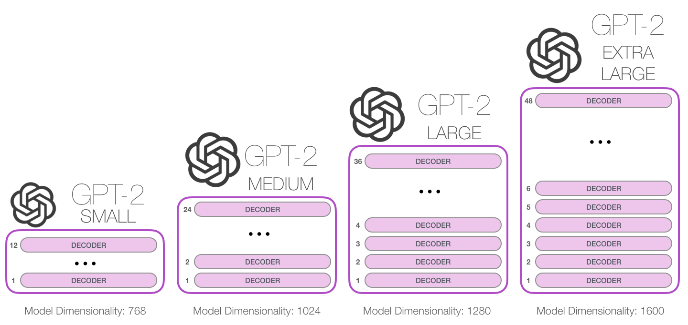

Slide 27

DialoGPT (MICROSOFT)
Dialog model fine tuned from GPT2
The model is trained on 147M multi-turn dialogue from Reddit discussion thread. The largest model can be trained in several hours on a 8 V100 machines (however this is not required), with distributed training and FP16 option.

Slide 28
Chatbots
Business Insider experts predict that by 2020, 80% of enterprises will use chatbots.
According to Lauren Foye, by 2022, banks can automate up to 90% of their customer interaction using chatbots.
A survey conducted by Spiceworks showed that 40% of large companies employing more than 500 people plan to implement one or more intelligent assistant or AI-based chat robot over corporate mobile devices in 2019.

Slide 29
Downstream language generation tasks
We focus on two downstream language generation tasks:
Essay writing
Text generation
Chatbots
Generating conversations (two concerns: 1. should be relevant to previous message, 2.should be relevant to context/personality of the speaker)

Slide 30
Essay writing
In this project an AI model is going to help you write essays on various topics. The AI model is a machine learning model that generates English language given some initial sentences.
Objective
The aim of the project is to introduce students with the latest technoligies in the field of language processing. This project also shows how the latest advancements in machine learning can be used in everyday activities.
Steps:
Select a topic from the available list of topics or choose your any topic.
Fine-tune the AI model using the data from text.
Run the model and use help from AI to complete a meaning essay on the topic.

Slide 31
Chat bots
Dialog datasets are small and it’s hard to learn enough about language and common-sense from them to be able to generate fluent and relevant responses.
Start by pretraining a language model on a very large corpus of text to be able to generate long stretches of contiguous coherent text,
Fine-tune this language model to adapt it to our end-task: dialog

Slide 32
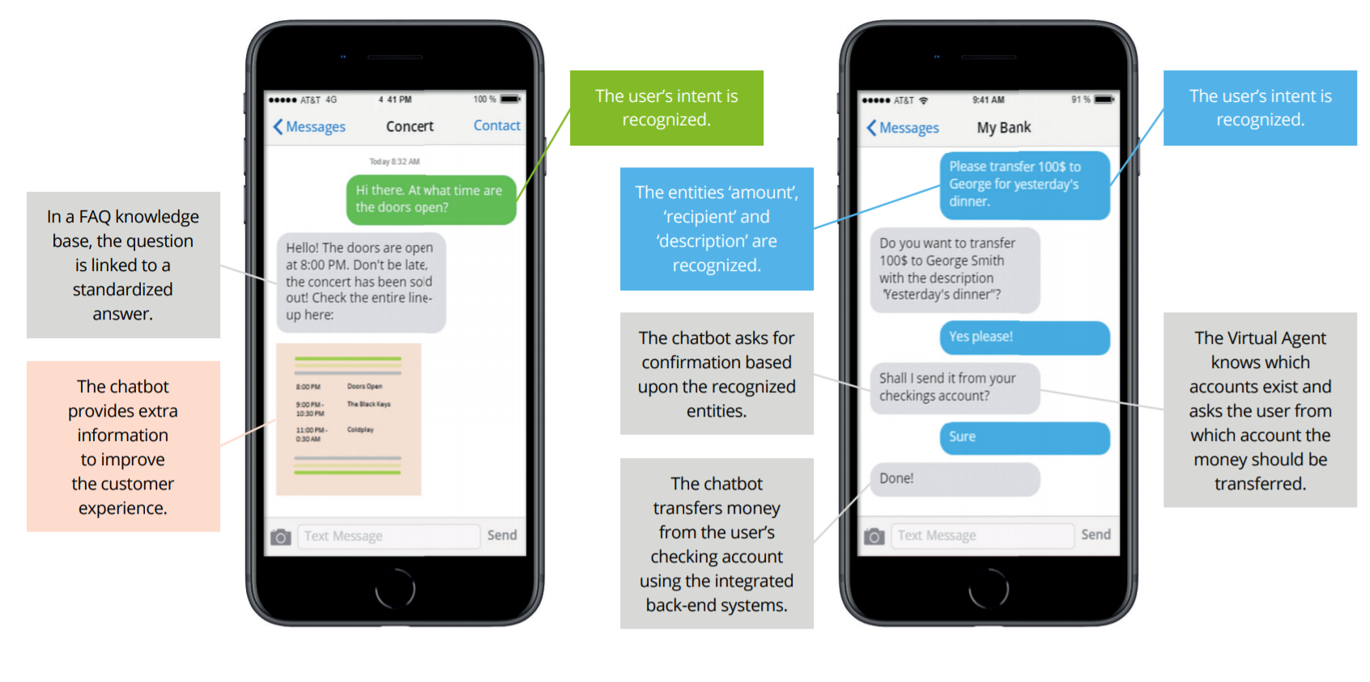

Slide 33
Chatbot Characteristics
Intent Recognition Ability to “guess” what the user is requesting, even if phrased unexpectedly. Good intent recognition is vital if you don’t want to annoy your users.
Dialog Management Go beyond simple Q&A and enable your Chatbot to have complex and meaningful conversations with the user.
Humanization Users get more engaged in conversation if a Chatbot acts more humanlike. Some Chatbots are able to detect and show emotions.
Interaction Channels How will users interact with your Chatbot? Choose a platform that connects easily with your webchat, app, social media platform or voice interface.
Task Automation Capability Does your Chatbot need to perform tasks for users? Make sure it has enough dialog capabilities and that it can connect to your back-end systems
Reporting & Monitoring Are your customers being helped? Are they happy? Does your contact center get less calls? Choose a Chatbot platform that tells you how it’s performing.
Ease of Implementation Some platforms require custom software development, while others allow business users to configure the Chatbot themselves.
Security & Compliance Do you have extra security requirements? Or do you need to be compliant with audit regulations? Security and logging capabilities can vary.
Notes:
There is a big variety in Chatbot development platforms. Below are a number of characteristics that should be taken into account when choosing the suitable platform to implement with your Chatbot.

